Slide 1


MRA Project ML 1
Name: Monica A
Batch: PGPDSBA.O.JUNE22.A
Email: monicaashokac1998@gmail.com

Slide 2
Table of Contents
Exploratory Data Analysis
Data Visualization of Sales using Dynamic Tableau
Summary on EDA
RFM Analysis Using KNIME Analysis
KNIME Workflow
Inferences

Slide 3
Problem Statement
An automobile parts manufacturing company has collected data of transactions for 3 years. They do not have any in-house data science team, thus they have hired you as their consultant. Your job is to use your magical data science skills to provide them with suitable insights about their data and their customers.

Slide 4
Exploratory Data Analysis

Slide 5

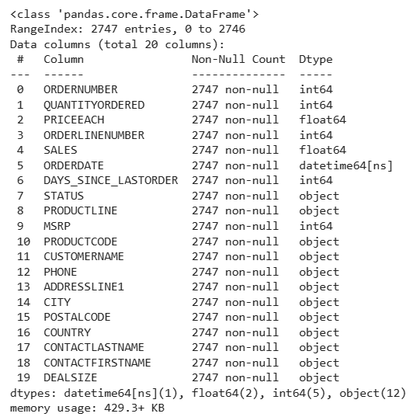
Primary Data Analysis
We have 2747 rows and 20 columns in the dataset
Out of which, there are several data types i.e.., 1 datetime, 2 float, 5 integers and 12 objects.
The data set is free of null values or duplicated values.

Slide 6
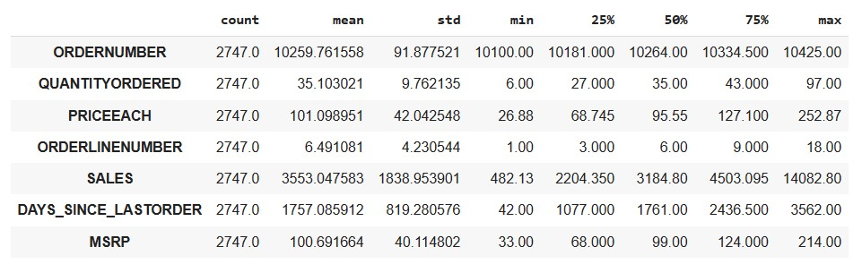
Statistical Inferences of Sales Data
The price each (price per unit) is in the range 26.88 to 252.87
As per the stats, the quantity of products placed is as low as 6 and goes up to 97 at the maximum, with a mean quantity ordered as 35.10
The MSRP (the manufacturer’s price) ranges from 33 to 214, with mean monetary value of 100.69
However, the sales price (quantity*priceeach) ranges from 482 to 12082.

Slide 7
Data Visualization of Sales using Dynamic Tableau

Slide 8
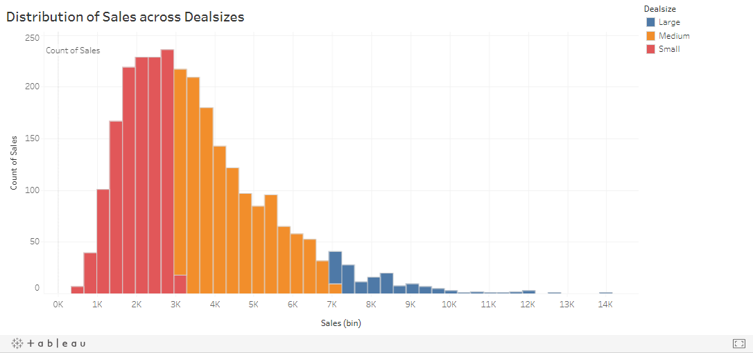
Distribution of Sales across Deal sizes
Note: All the graphs are embedded from Tableau making the presentation interactive.

Slide 9
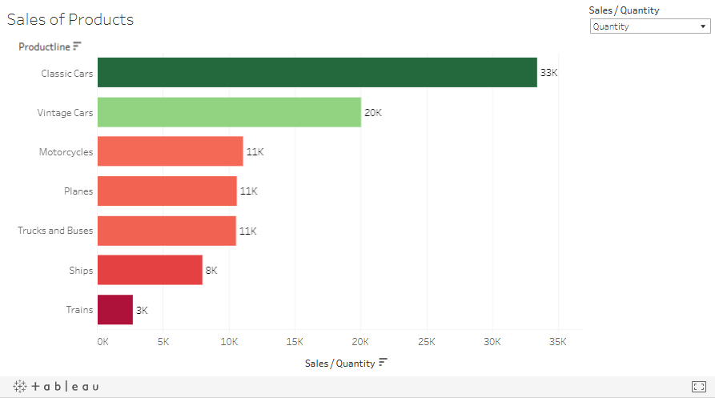
Distribution of Products and their Sales/Quantity.
As depicted below the Classic cars are both highly ordered and Sold product contributing to major sales.
Followed by Classic car, vintage cars take up the second place. The quantity ordered for Trucks, Planes and motorcycles are more or less same
However, the sales earned (price) seems to be higher for Trucks

Slide 10
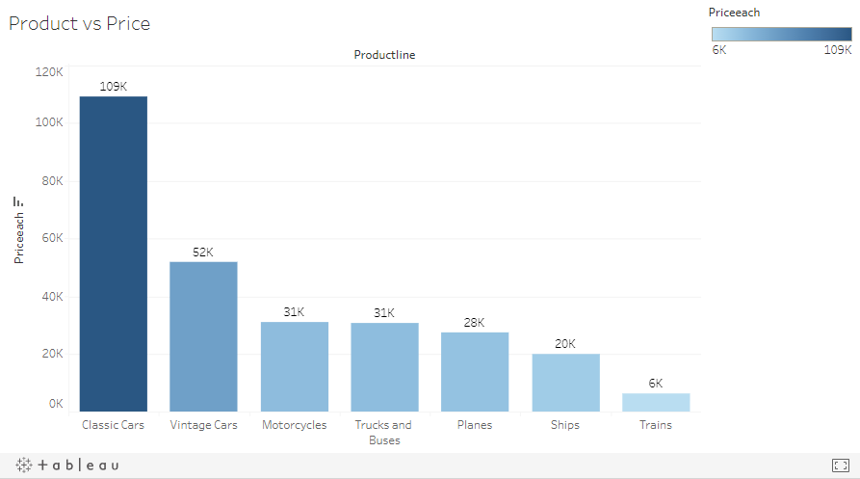
Product vs Price each (price per quantity)

Slide 11
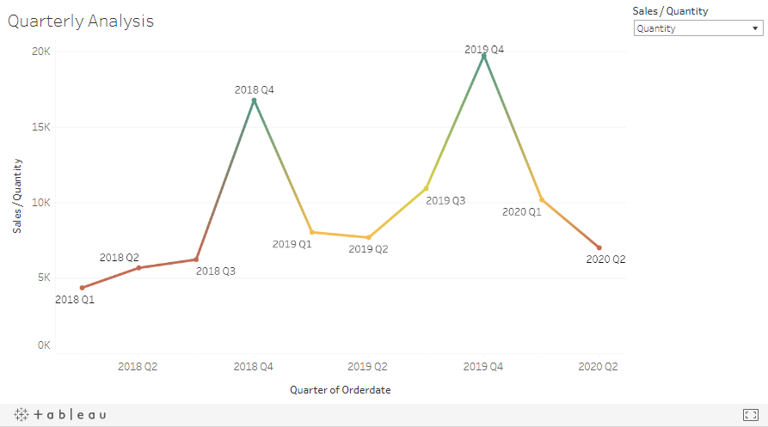
Quarterly Trend of Sales across years.
From the below analysis, we find a repeating pattern in the sales and quantity ordered. The Q4 has always been the highly active. Understanding this further is necessary.
The Q1 is usually the least active phase of the year.

Slide 12
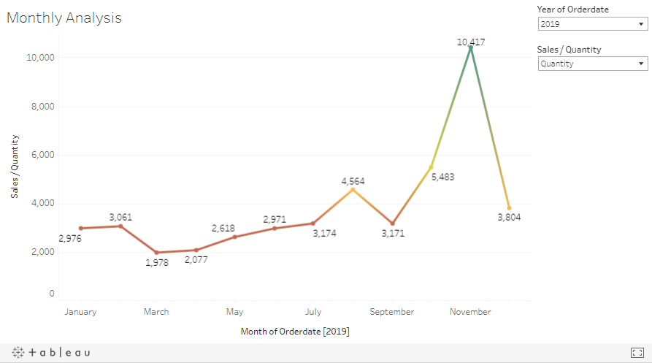
Monthly Trend of Sales across years.
In continuation to Quarterly Analysis, we can see the below monthly trends of each year. The sales is usually highest in the month of November followed by October for both 2018 and 2019 (the filters in the graph is interactive)
As of for 2020, we only have data up to May and it is also the highest.

Slide 13
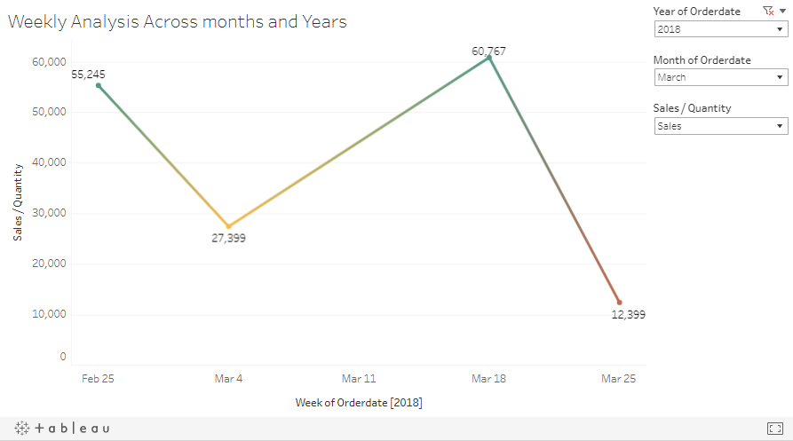
Weekly Trend of Sales across months and years.
As per the below depiction, in general the second and third weeks seems to more active compared to the first and last weeks for the months.

Slide 14
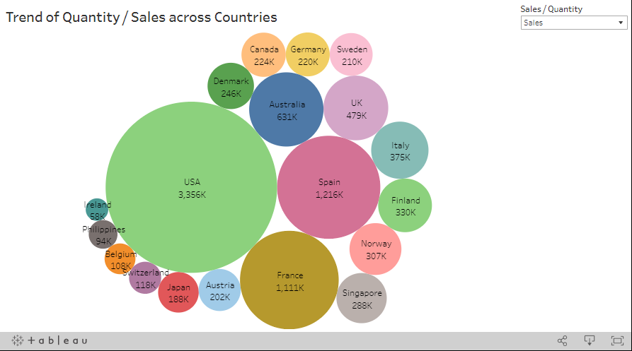
Trend of Sales among countries
USA is most contributing country with Sales 3356K and Ireland is the least contributing country with Sales of 68K.
Followed by USA, Spain, France, Australia and UK are the countries whose Sales ranges from 1261K to 479K.
The trend in sales is almost similar to the trend in Quantity Ordered.

Slide 15
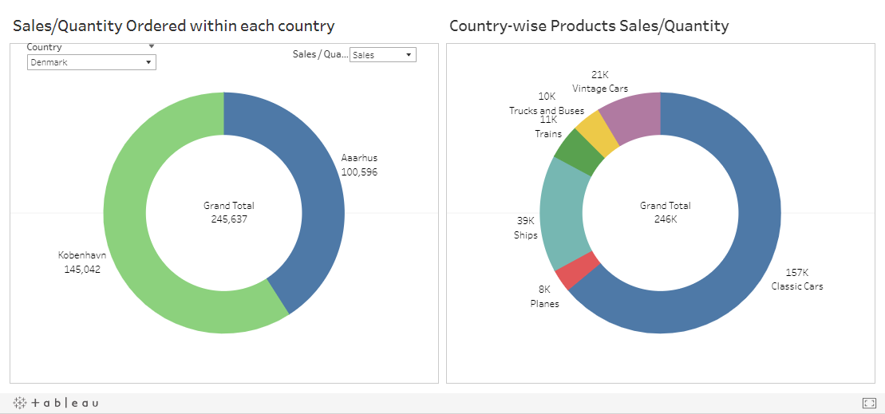
Country and City-wise Analysis
The below visualization would help us understand the Sales distribution between different cities of a particular nation and products sold.
The Classic and vintage cars are the most sold products. Trains and Ships are among the least sold.

Slide 16
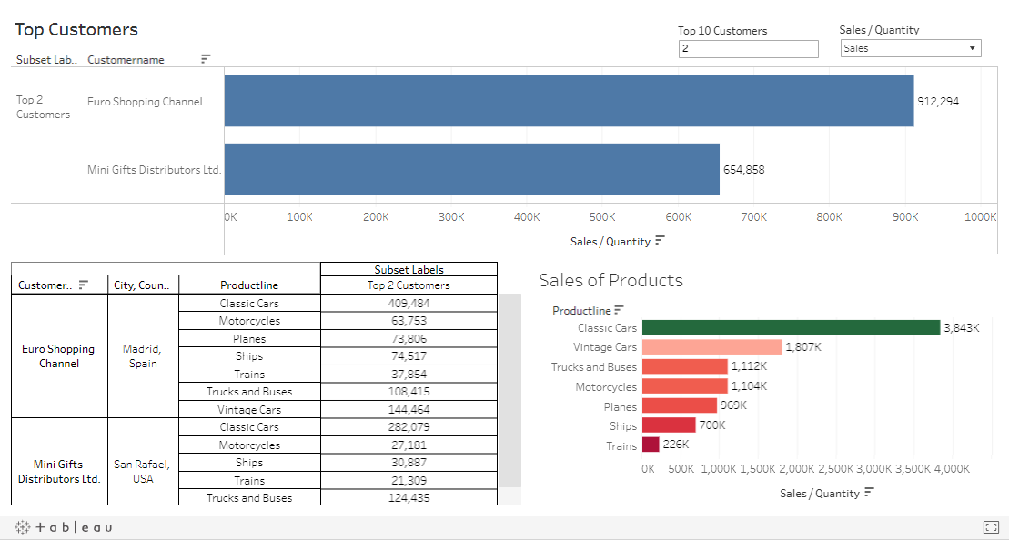

Slide 17
Data Analysis Inferences
The highest selling products lines are classic cars, vintage cars and motorcycles irrespective of countries
Though the quantity ordered for motorcycles are almost similar to that of Trucks, the sales or amount earned for Trucks is a bit larger than motorcycles
As we have analysed the data the sales follows a known pattern of inflation in Quarter 3 and 4 especially in the month of November.
Apart from November, the months like October seems to be a good time for sales. But, the Quarters 1 is the least active phase of the year
We need to check on the above and may be come up with some strategies to increase the sales

Slide 18
RFM Analysis Using KNIME Analysis

Slide 19
KNIME Workflow (1/2)
The Sales Dataset does not contain any missing data. So not a lot of pre-processing of data was done
Once the dataset is imported, the data was grouped by customer name. This ensures to avoid duplication of same orders.
Further the Recency, Frequency and Monetary Values were calculated as below.
Recency – This is the difference between the Max Order Date i.e. 01-06-2020 and “Order Date”
Frequency – This is the count of orders placed by a customer
Monetary – This is the sum of “Sales”

Slide 20
KNIME Workflow (2/2)
Now that we have all the calculated fields in place, the next step is clustering.
The data was clustered using “Auto Binner” and into 4 segments and renamed namely “High”, “Med”, “Low” and “Least”
The “High” segment consists of the customers who are highly active
The “Med” group are as well active must comparatively less compared to High and are in the risk of churning.
The “Low” segment consists of the churning customers, but they tend to return once in a while.
The “Least” customers are the lost customers

Slide 21
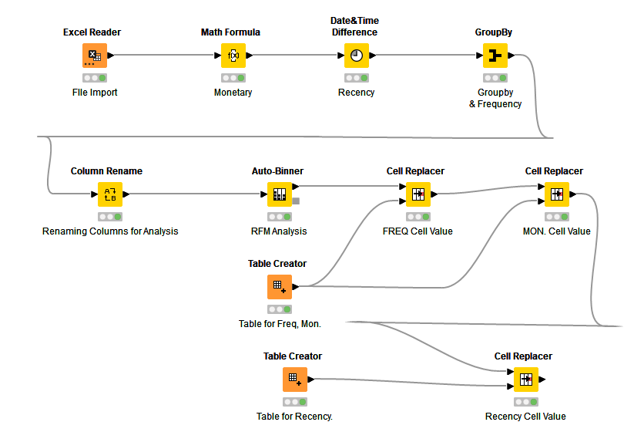
RFM Analysis Work Flow

Slide 22
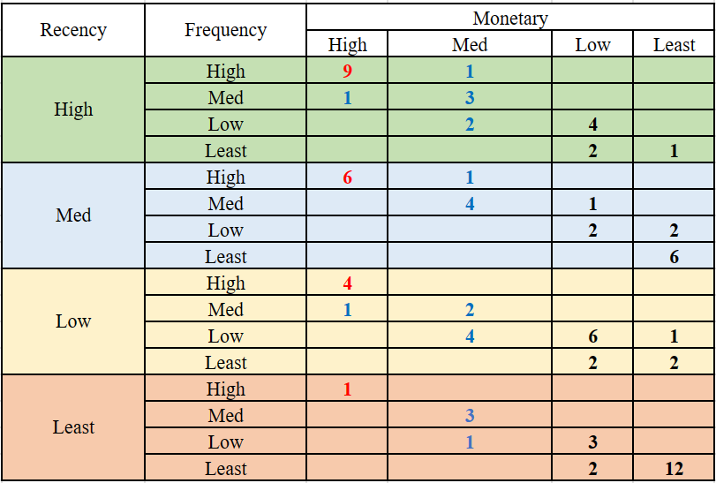
Pivot Analysis on KNIME Exported Data
The customers in the high band are the most recent and active customers.
The Customers in the med band are active but probably the monetary value are mostly lower.
But these people are the potential target for the sales and are at the risk of churning.
The customers in the low band are churning customers who only visit occasionally.
The customers in the least band are the lost customers.

Slide 23
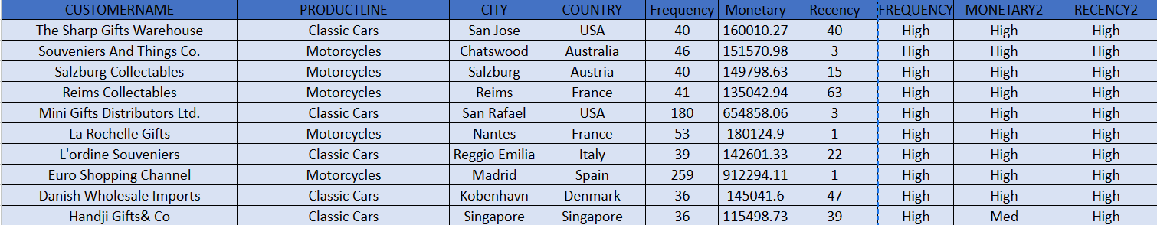
Best Customers

Slide 24
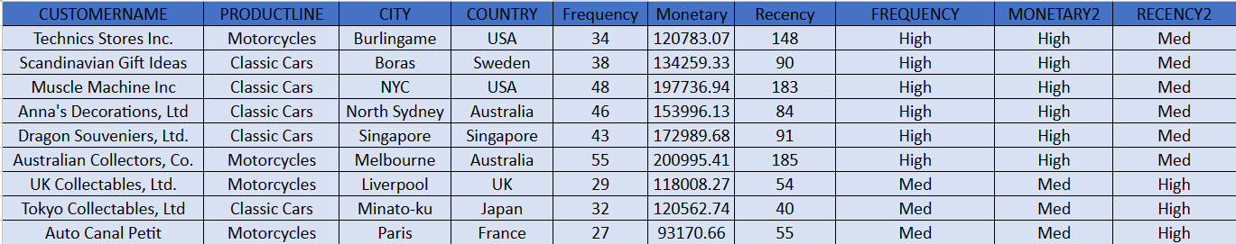
Loyal Customers

Slide 25
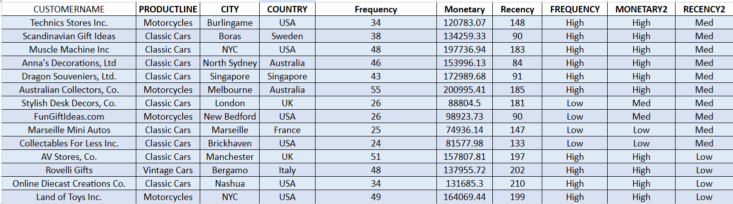
Churning Customers

Slide 26
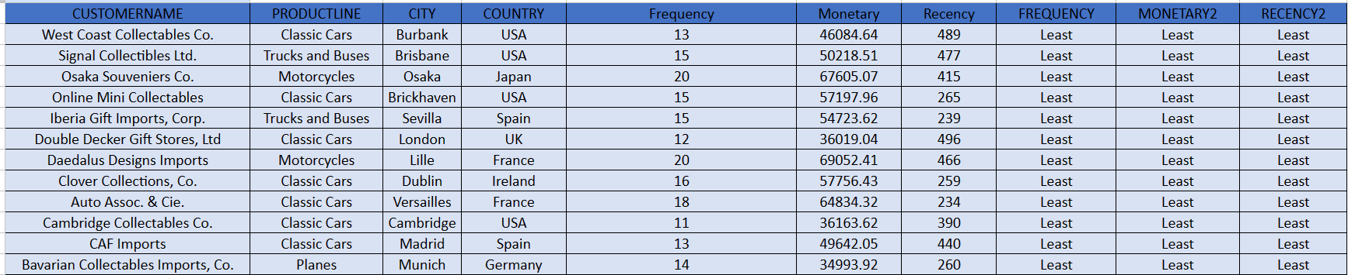
Lost Customers

Slide 27
Inferences on RFM Analysis (1/2)
We may have to first concentrate on the customers whose values are of medium range and are frequent and try to offer them some offers or other advantages to increase their monetary contributions.
As a part of Data Analysis, we did note that the Quarter 4 is highly active. We might want to take in consideration when implementing the above.
Any offers or advantages or investments during first quarter can be minimal compared to other. However, we might consider taking a survey to understand the sales drop during those period.

Slide 28
Inferences on RFM Analysis (2/2)
Once we concentrate on the medium monetary valued customers, we must concentrate on the potential customers in the medium level (“Med”) band.
Investing in this band might be a good thing to consider, as these people are the risk of churning.
The customers in the “Least” Category might be avoided in marketing as the are lost customers.
However, a survey or feedback is to be collected to ensure the reason for loss is not our error.
If there is any kind of feedback, we might have to work on them and make sure to attract new customers as well as retain existing customers.

Slide 29
Thank You ☺

